Slide 1


Suhas SD
08 sept 2024

Slide 2

Outline
Executive Summary
Introduction
Methodology
Results
Conclusion
Appendix

Slide 3
Executive Summary
This report presents a detailed analysis of SpaceX’s launch site locations and Falcon 9 landing predictions, leveraging geospatial insights, predictive modeling, and interactive dashboards.
Methodologies:
Geospatial Analysis:
Goal: Assess proximity of launch sites to railways, highways, coastlines, and cities.
Tools: Used Folium for mapping and distance calculation, revealing close proximities to key infrastructure.

Slide 4
Executive Summary
Predictive Modeling:
Goal: Predict Falcon 9 landing success.
Models Tested: Logistic Regression, SVM, Decision Tree, K-Nearest Neighbors.
Best Model: SVM with 84.8% cross-validation accuracy and 83.3% test accuracy, optimized using GridSearchCV.
Interactive Dashboard:
Goal: Visualize SpaceX launch data dynamically.
Features: Created with Plotly Dash, including filters, pie charts, and scatter plots for exploring success rates and payload correlations.

Slide 5
Executive Summary
Results:
Geospatial Analysis: Confirmed strategic placement of launch sites near critical infrastructure.
Predictive Modeling: SVM emerged as the most accurate model for landing success predictions.
Dashboard: Provided effective visualization and interaction with launch data, enhancing analysis capabilities.
This concise overview integrates key findings and methodologies, offering a snapshot of the analysis and its implications.

Slide 6
Introduction
Project Background and Context: This project examines SpaceX launch sites and Falcon 9 landing predictions to optimize site selection and mission planning through spatial and predictive analysis.
Problems to Address:
Assess the proximity of launch sites to railways, highways, coastlines, and cities.
Identify the best model for predicting Falcon 9 landing success.
Create a dashboard for visualizing launch success and payload impacts.
The goal is to leverage data for improved launch site utilization and landing accuracy.

Slide 7

Section 1

Slide 8
Methodology
Executive Summary
Data collection methodology:
Gathered data from SpaceX launch records and related sources.
Perform data wrangling
Cleaned, wrangled, and transformed data for analysis and visualization.Performed exploratory data analysis (EDA) using visualization and SQL
Perform interactive visual analytics using Folium and Plotly Dash
Perform predictive analysis using classification models
Develope classification models, optimized hyperparameters, and assessed performance using accuracy metrics.

Slide 9
Data Collection
Source Identification
Data Sources: Identified relevant datasets from online repositories and internal sources.
Data Acquisition
Download: Retrieved data files from specified URLs or databases.
APIs: Used APIs for real-time data extraction when needed.
Data Storage
Local Storage: Saved datasets to local directories or cloud storage.
Database: Imported data into relational databases for structured access.
Start
|
Identify Data Sources
|
V
Retrieve Data (Download, APIs)
|
V
Store Data (Local, Database)
|
V
End

Slide 10
Data Collection – SpaceX API
Start
|
Identify API Endpoints
V
Make REST API Calls (GET Requests)
V
Retrieve Data (JSON Format)
V
Store Data (Local Files, Database)
V
End
API Endpoint Identification
Endpoints: Selected SpaceX REST API endpoints for launch data.
Documentation: Referenced SpaceX API documentation for available endpoints.
REST API Calls
GET Requests: Used GET requests to retrieve launch records and rocket details.
Authentication: Managed any required API keys or tokens.
Data Retrieval
Format: Collected data in JSON format.
Integration: Integrated data into the analysis environment.
Data Storage
Local Files: Saved retrieved data to local CSV or JSON files.
Database: Optionally imported data into a relational database for further analysis.

Slide 11
Data Collection - Scraping
Start
|
Identify Sites
|
Use Scraping Tools
|
Fetch & Parse HTML
|
Extract & Store Data
|
End
Identify Target Sites Selected relevant websites and pages.
Scraping Tools Used BeautifulSoup and Scrapy for data extraction.
Data Extraction Parsed HTML to extract needed data.
Store Data Saved data in CSV/JSON formats.

Slide 12
Data Wrangling
Data Processing Steps
Cleaned Data: Addressed missing values and duplicates.
Transformed Data: Standardized formats and normalized values.
Integrated Data: Merged datasets and aligned schemas.
Engineered Features: Created new features and encoded categorical variables.
Start
|
Data Cleaning
|
Data Transformation
|
Data Integration
|
Feature Engineering
|
End

Slide 13
EDA with Data Visualization
Charts and Their Purposes
Pie Charts: Visualized categorical success rates by launch site.
Scatter Plots: Analyzed payload mass vs. launch success.
Histograms: Examined distribution of payload masses and other variables

Slide 14
EDA with SQL
Charts and Their Purposes
Pie Charts: Visualized categorical success rates by launch site.
Scatter Plots: Analyzed payload mass vs. launch success.
Histograms: Examined distribution of payload masses and other variables

Slide 15
Build an Interactive Map with Folium
Map Objects Created and Their Purpose
Markers: Indicated proximity to cities, railways, and highways.
Polylines: Visualized distances between launch sites and key locations.
Circles: (if used) Represented proximity zones around launch sites.
Purpose These objects provided insights into geographic relationships and proximities.

Slide 16
Build a Dashboard with Plotly Dash
Plots/Graphs Added
Pie Chart: Displayed success/failure rates by launch site.
Scatter Plot: Showed correlation between payload mass and launch success.
Interactions
Dropdown Menu: Allowed selection of specific launch sites.
Range Slider: Enabled filtering payload mass for detailed analysis.
Purpose These visualizations and interactions provided a comprehensive view of launch success and payload impacts.

Slide 17
Predictive Analysis (Classification)
Model Development Process
Built Models: Logistic Regression, SVM, Decision Tree, KNN.
Evaluation: Used cross-validation and test accuracy.
Improvement: Tuned hyperparameters using GridSearchCV.
Best Model: SVM with kernel='sigmoid' and C=1 achieved highest accuracy.

Slide 18
Results
Exploratory Data Analysis (EDA) Results
Key Findings: Identified that launch sites are close to railways, highways, and coastlines, with varying distances from cities. Interactive charts showed success rates and payload correlations.
Interactive Analytics Demo
Screenshots: Demonstrated interactive maps with launch site proximities to cities, railways, highways, and coastlines, and dashboards illustrating launch success by site and payload vs. success correlations.
Predictive Analysis Results
Model Performance: Best model, SVM with kernel='sigmoid', achieved an accuracy of 83.33% on test data.

Slide 19

Section 2

Slide 20
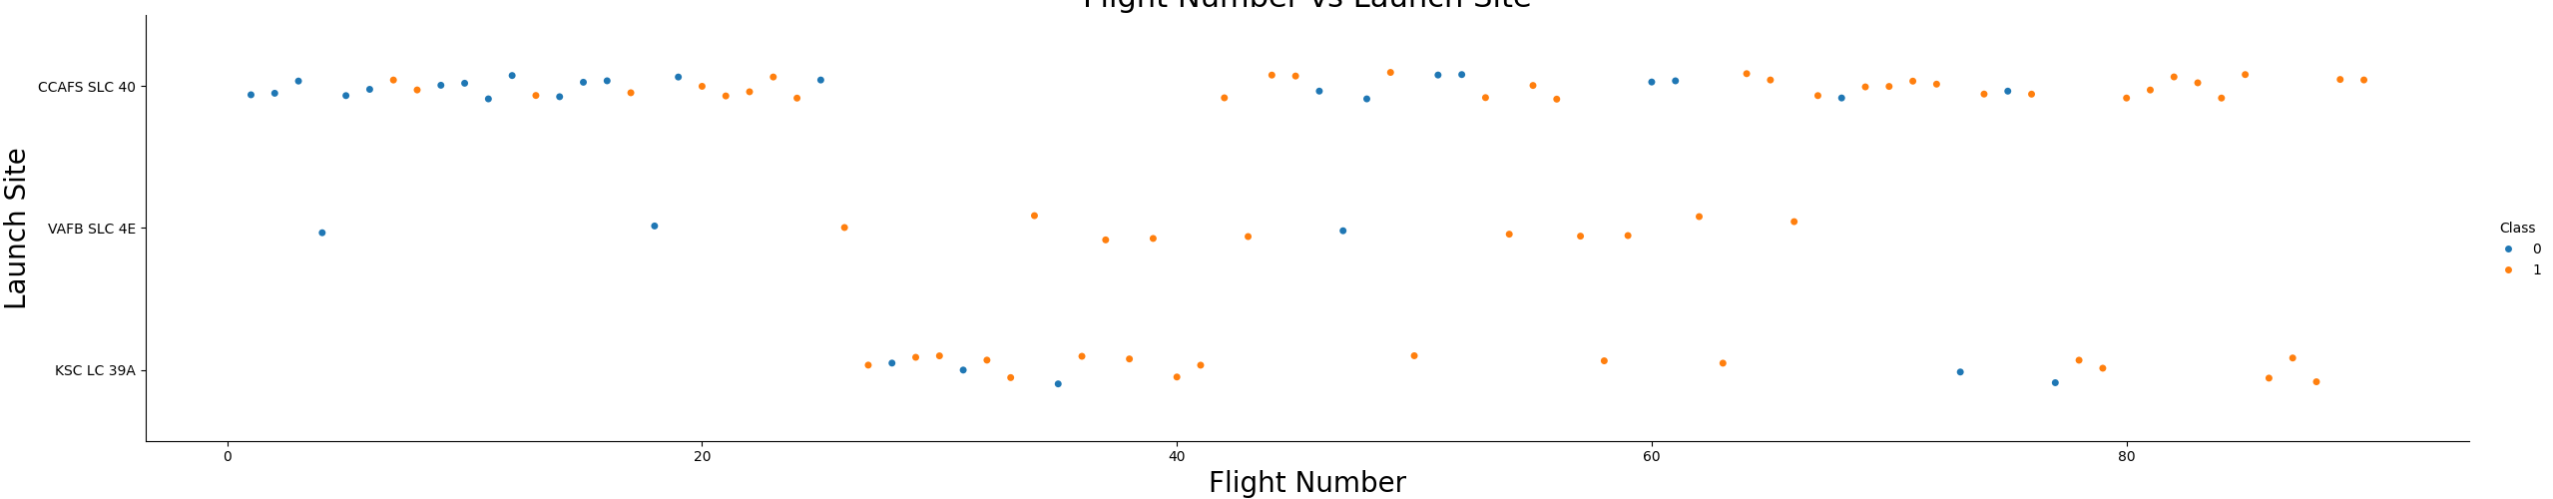
Flight Number vs. Launch Site
Scatter plot showing flight numbers against launch sites, indicating the number of launches per site.

Slide 21
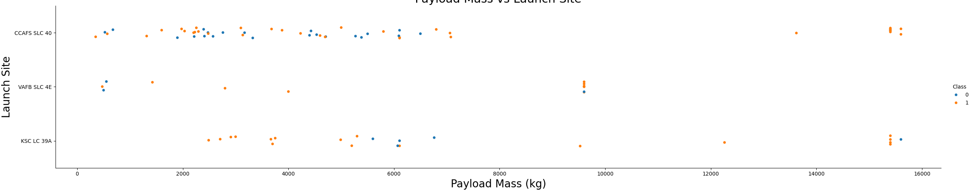
Payload vs. Launch Site
Bar chart showing the correlation between payload and launch site, analyzing payload distribution.

Slide 22
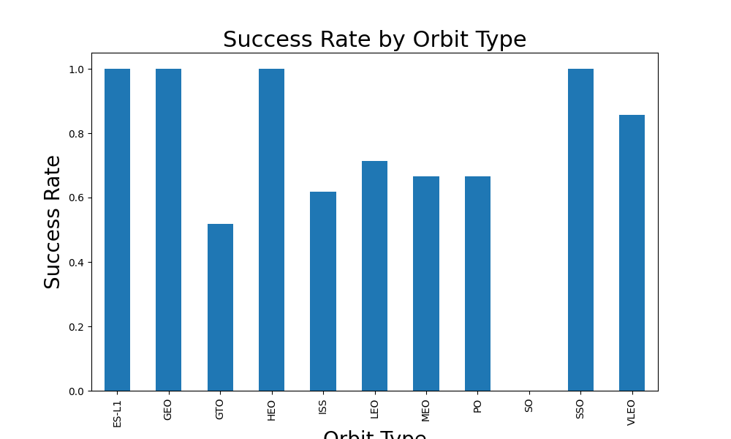
Success Rate vs. Orbit Type
Bar chart representing success rates across different orbit types.

Slide 23
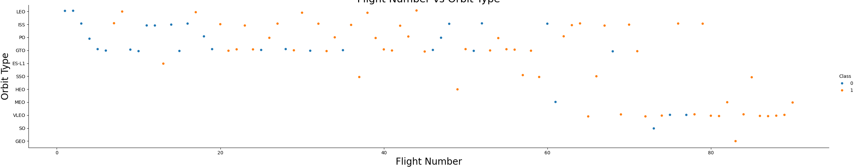
Flight Number vs. Orbit Type
Scatter plot of flight number versus orbit type to study launch patterns by orbit.

Slide 24
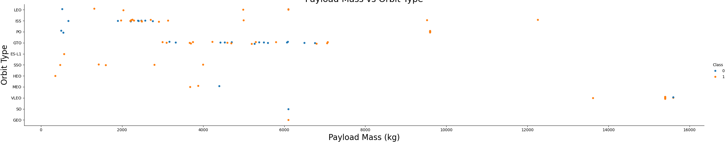
Payload vs. Orbit Type
Scatter plot showing payload against orbit type, helping visualize payload capacity trends.

Slide 25
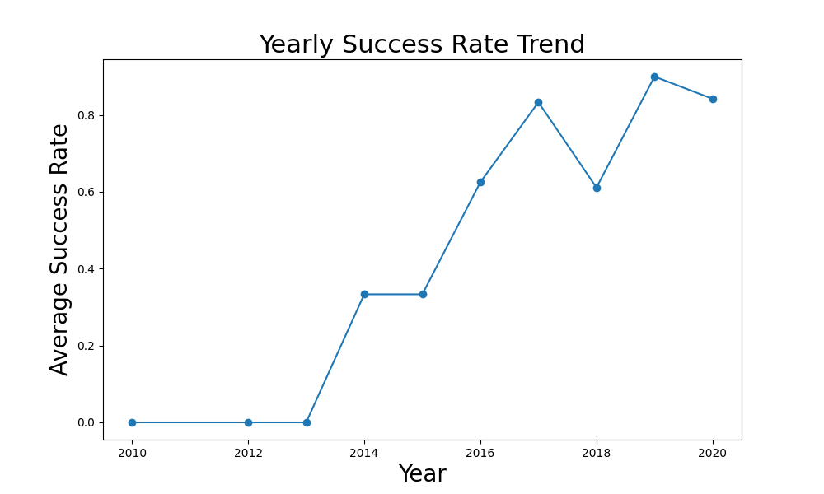
Launch Success Yearly Trend
Line chart showing the trend of yearly launch successes, highlighting SpaceX’s success over time.

Slide 26
All Launch Site Names
%%sqlSELECT DISTINCT "Launch_Site"FROM SPACEXTABLE;
SQL query to fetch all distinct launch site names, listing available launch sites.
Launch_Site
CCAFS LC-40
VAFB SLC-4E
KSC LC-39A
CCAFS SLC-40

Slide 27
Launch Site Names Begin with 'CCA'
%%sqlSELECT *FROM SPACEXTABLEWHERE "Launch_Site" LIKE 'CCA%‘
Date | Time (UTC) | Booster_Version | Launch_Site | Payload | PAYLOAD_MASS__KG_ | Orbit | Customer | Mission_Outcome | Landing_Outcome
2010-06-04 | 18:45:00 | F9 v1.0 B0003 | CCAFS LC-40 | Dragon Spacecraft Qualification Unit | 0 | LEO | SpaceX | Success | Failure (parachute)
2010-12-08 | 15:43:00 | F9 v1.0 B0004 | CCAFS LC-40 | Dragon demo flight C1, two CubeSats, barrel of Brouere cheese | 0 | LEO (ISS) | NASA (COTS) NRO | Success | Failure (parachute)
2012-05-22 | 7:44:00 | F9 v1.0 B0005 | CCAFS LC-40 | Dragon demo flight C2 | 525 | LEO (ISS) | NASA (COTS) | Success | No attempt
2012-10-08 | 0:35:00 | F9 v1.0 B0006 | CCAFS LC-40 | SpaceX CRS-1 | 500 | LEO (ISS) | NASA (CRS) | Success | No attempt
2013-03-01 | 15:10:00 | F9 v1.0 B0007 | CCAFS LC-40 | SpaceX CRS-2 | 677 | LEO (ISS) | NASA (CRS) | Success | No attempt

Slide 28
Total Payload Mass
%%sqlSELECT SUM("PAYLOAD_MASS__KG_") AS Total_Payload_MassFROM SPACEXTABLEWHERE "Customer" = 'NASA (CRS)';
Total_Payload_Mass = 45596
SQL query to calculate the total payload mass delivered by NASA missions.

Slide 29
Average Payload Mass by F9 v1.1
%%sqlSELECT AVG("PAYLOAD_MASS__KG_") AS Avg_Payload_MassFROM SPACEXTABLEWHERE "Booster_Version" = 'F9 v1.1';
Avg_Payload_Mass = 2928.4
SQL query to calculate the average payload mass for F9 v1.1 missions.

Slide 30
First Successful Ground Landing Date
%%sqlSELECT MIN("Date") AS First_Successful_LandingFROM SPACEXTABLEWHERE "Landing_Outcome" = 'Success (ground pad)';
First_Successful_Landing = 2015-12-22
SQL query identifying the date of the first successful ground landing.

Slide 31
Successful Drone Ship Landing with Payload between 4000 and 6000
%%sqlSELECT "Booster_Version"FROM SPACEXTABLEWHERE "Landing_Outcome" = 'Success (drone ship)'AND "PAYLOAD_MASS__KG_" > 4000AND "PAYLOAD_MASS__KG_" < 6000;
SQL query listing booster versions that successfully landed on a drone ship with payloads between 4000 and 6000 kg.
Booster_Version
F9 FT B1022
F9 FT B1026
F9 FT B1021.2
F9 FT B1031.2

Slide 32
Total Number of Successful and Failure Mission Outcomes
%%sqlSELECT "Landing_Outcome", COUNT(*) AS Total_CountFROM SPACEXTABLEGROUP BY "Landing_Outcome“;
SQL query showing a breakdown of landing outcomes, detailing successful and failed missions.
Landing_Outcome | Total_Count
Controlled (ocean) | 5
Failure | 3
Failure (drone ship) | 5
Failure (parachute) | 2
No attempt | 21
No attempt | 1
Precluded (drone ship) | 1
Success | 38
Success (drone ship) | 14
Success (ground pad) | 9
Uncontrolled (ocean) | 2

Slide 33
Boosters Carried Maximum Payload
Booster_Version
F9 B5 B1048.4
F9 B5 B1049.4
F9 B5 B1051.3
F9 B5 B1056.4
F9 B5 B1048.5
F9 B5 B1051.4
F9 B5 B1049.5
F9 B5 B1060.2
F9 B5 B1058.3
F9 B5 B1051.6
F9 B5 B1060.3
F9 B5 B1049.7
%%sqlSELECT "Booster_Version"FROM SPACEXTABLEWHERE "PAYLOAD_MASS__KG_" = (SELECT MAX("PAYLOAD_MASS__KG_") FROM SPACEXTABLE);
SQL query listing boosters that carried the maximum payload.

Slide 34
2015 Launch Records
%%sqlSELECT substr("Date", 6, 2) AS Month, "Booster_Version", "Launch_Site", "Landing_Outcome"FROM SPACEXTABLEWHERE "Landing_Outcome" = 'Failure (drone ship)'AND substr("Date", 0, 5) = '2015';
SQL query showing launch outcomes of failed drone ship landings in 2015.
Month | Booster_Version | Launch_Site | Landing_Outcome
01 | F9 v1.1 B1012 | CCAFS LC-40 | Failure (drone ship)
04 | F9 v1.1 B1015 | CCAFS LC-40 | Failure (drone ship)

Slide 35
Rank Landing Outcomes Between 2010-06-04 and 2017-03-20
%%sqlSELECT "Landing_Outcome", COUNT(*) AS Outcome_CountFROM SPACEXTABLEWHERE "Date" BETWEEN '2010-06-04' AND '2017-03-20'GROUP BY "Landing_Outcome"ORDER BY Outcome_Count DESC;
SQL query ranking landing outcomes between 2010 and 2017 based on the number of occurrences.
Landing_Outcome | Outcome_Count
No attempt | 10
Success (drone ship) | 5
Failure (drone ship) | 5
Success (ground pad) | 3
Controlled (ocean) | 3
Uncontrolled (ocean) | 2
Failure (parachute) | 2
Precluded (drone ship) | 1

Slide 36

Section 3

Slide 37
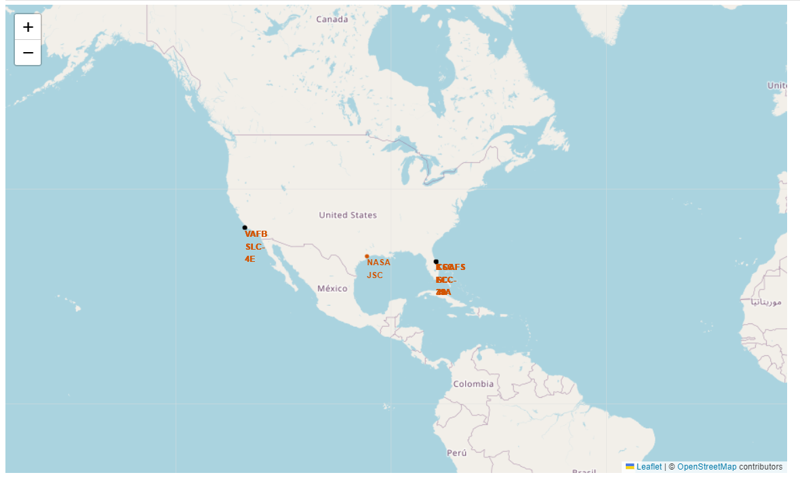
<Folium Map Screenshot 1>
Screenshot of a Folium map showing launch site locations and relevant markers.
Proximity to equator is shown

Slide 38
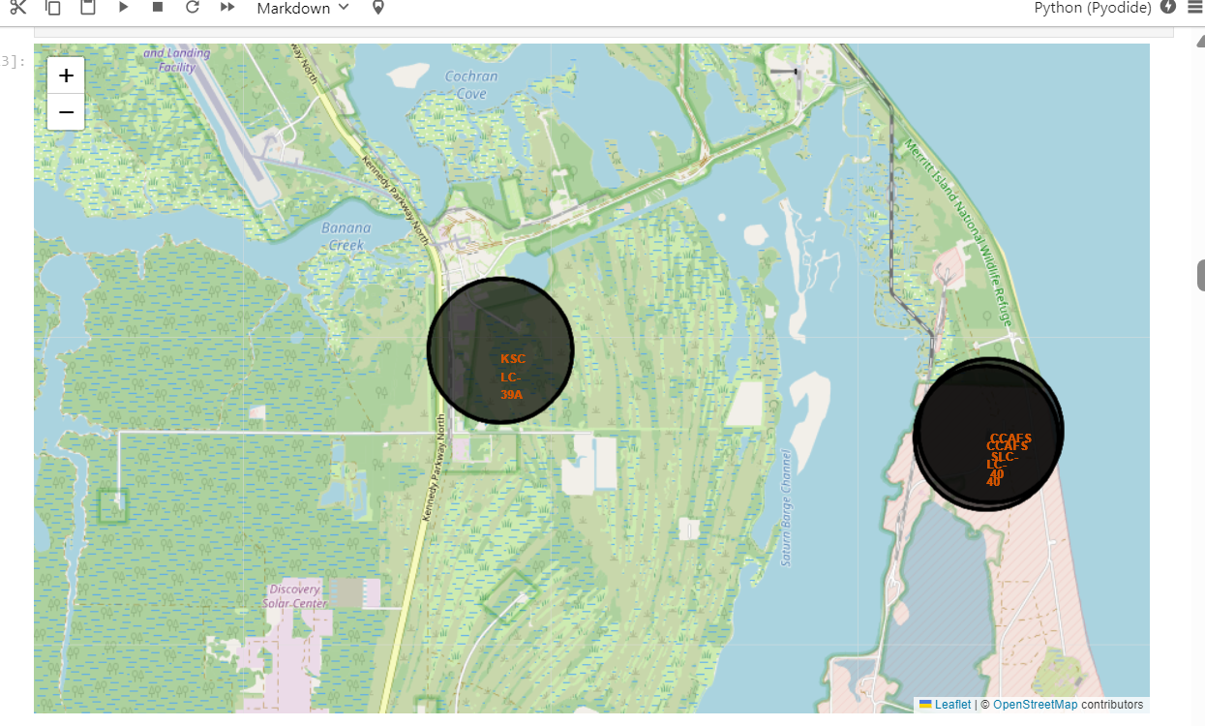
<Folium Map Screenshot 2>
Screenshot of a Folium map showing color-labeled launch outcomes.
The cape caneveraval has highest launch activity

Slide 39
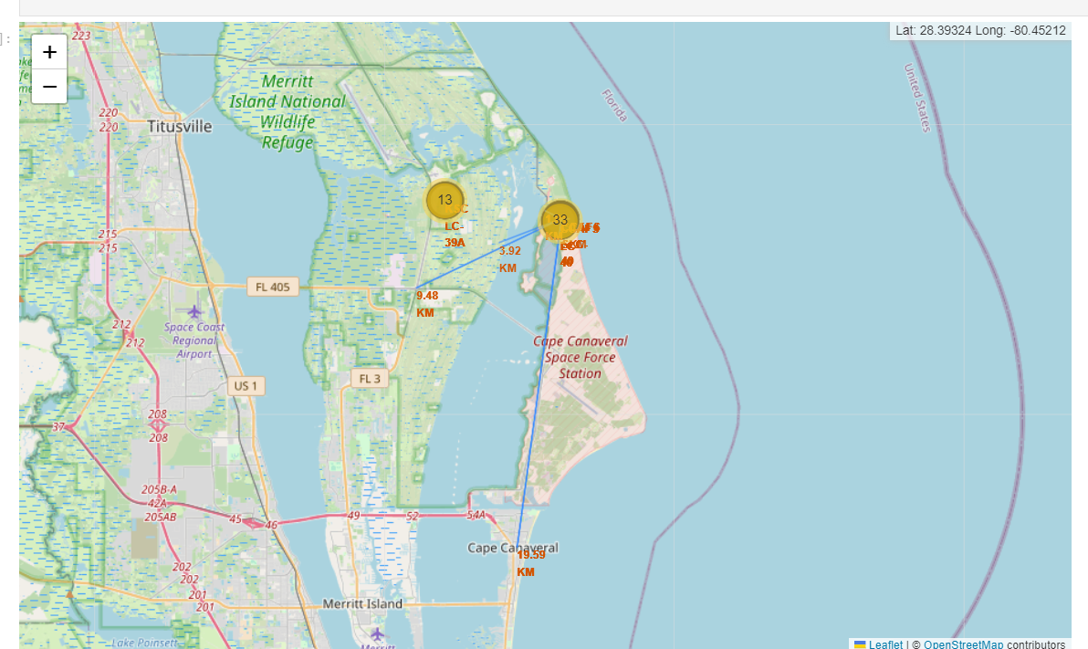
<Folium Map Screenshot 3>
Screenshot of a Folium map showing proximity of a selected launch site to infrastructure.
Proximity to city , highway and railway is shown from CC

Slide 40

Section 4

Slide 41
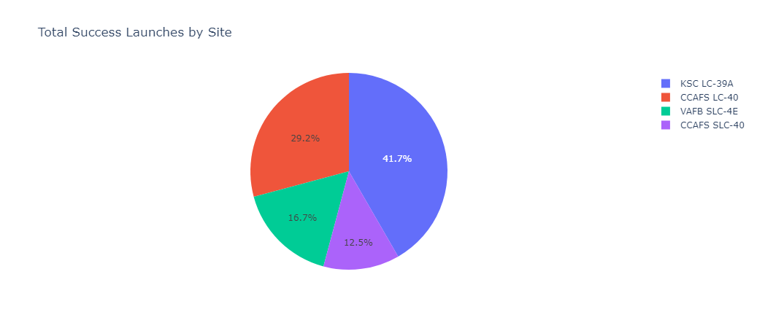
<Dashboard Screenshot 1>
Screenshot of a dashboard visualizing SpaceX launch success data interactively.

Slide 42
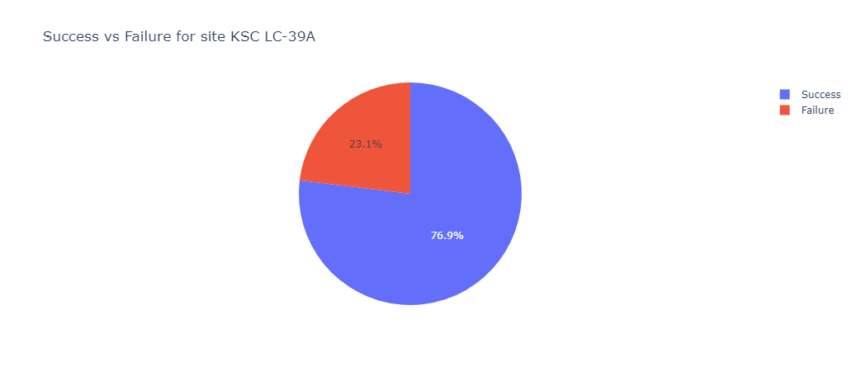
<Dashboard Screenshot 2>
Screenshot of a dashboard showcasing payload vs. success correlations.

Slide 43
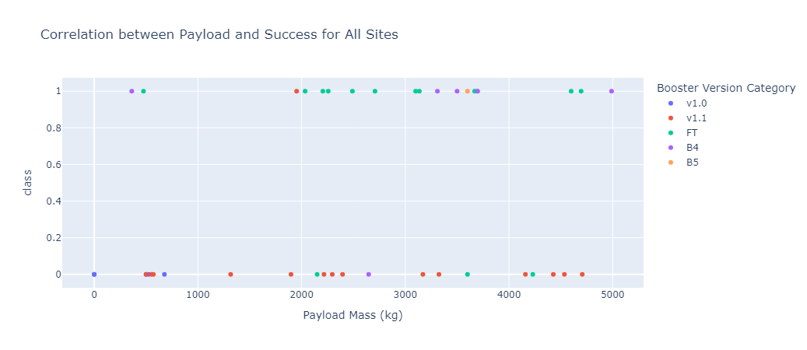
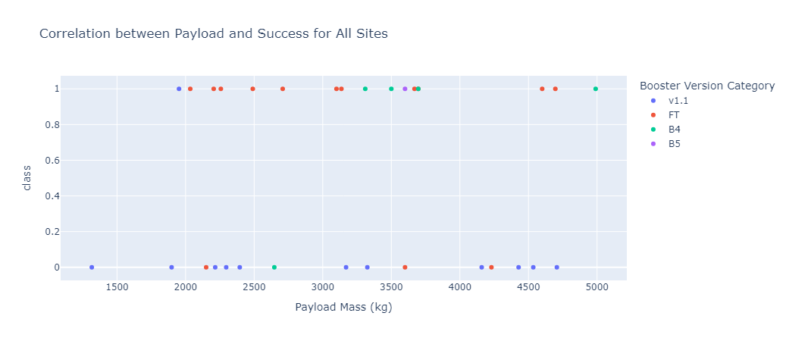
<Dashboard Screenshot 3>
Screenshot of a dashboard showing launch site success rates interactively.

Slide 44

Section 5

Slide 45
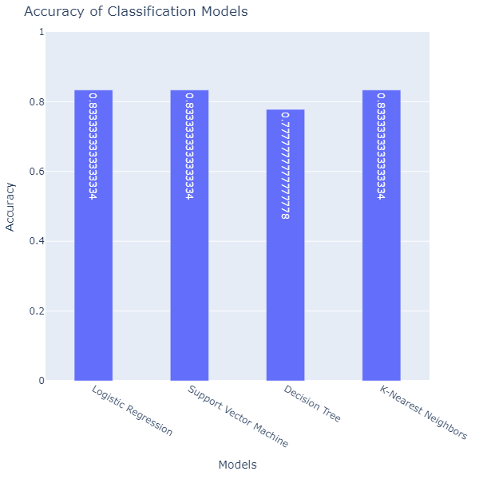
Classification Accuracy
Bar chart visualizing the accuracy of different classification models, showing SVM as the best performer.

Slide 46
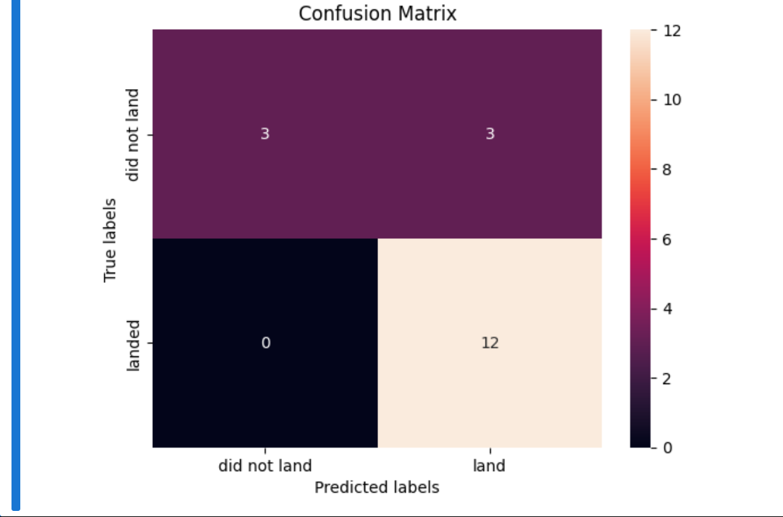
Confusion Matrix
Confusion matrix displaying the performance of the SVM model, along with an explanation of its success in predicting outcomes.

Slide 47
Conclusions
Insights: Launch sites are strategically located near infrastructure (railways, highways) and coastlines, balancing operational efficiency with safety. Visualizations and interactive tools enhanced understanding of spatial and success factors.
Predictive Modeling: SVM proved to be the most effective classifier, optimizing accuracy for predicting Falcon 9 first stage landings.
Next Steps: Leverage these insights for operational improvements and refine models with additional data for better predictions.

Slide 48
Appendix
Git links
SDSuhas/spacex-notebooks (github.com)

Slide 49


